Slide 1
Stream & File I/O
Lab2

Slide 2
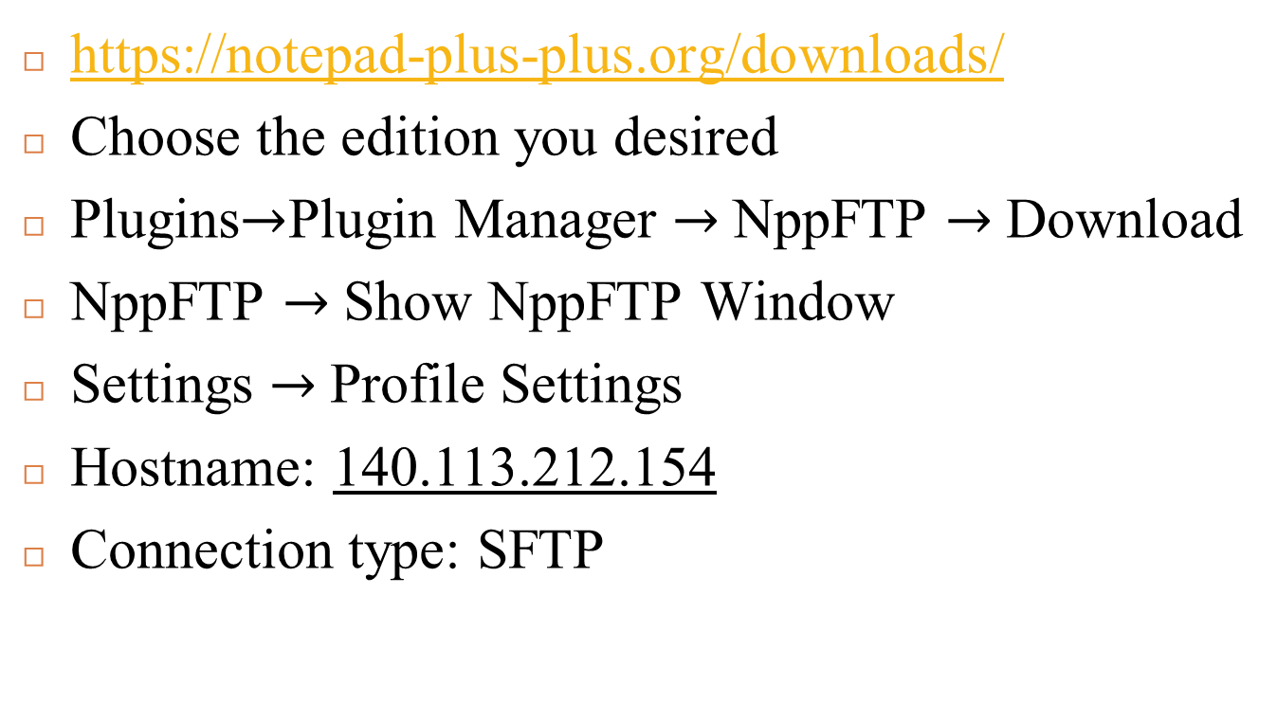
Notepad++
https://notepad-plus-plus.org/downloads/
Choose the edition you desired
Plugins$→$Plugin Manager $→$NppFTP $→$Download
NppFTP $→$Show NppFTP Window
Settings $→$Profile Settings
Hostname: 140.113.212.154
Connection type: SFTP

Slide 3
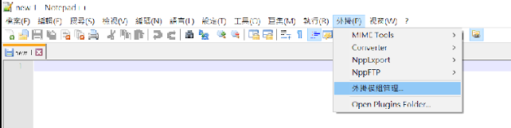
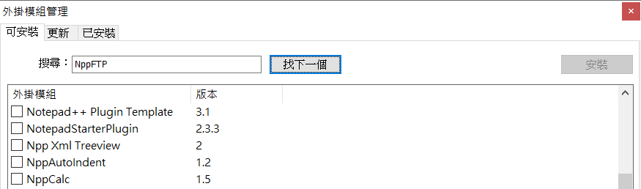
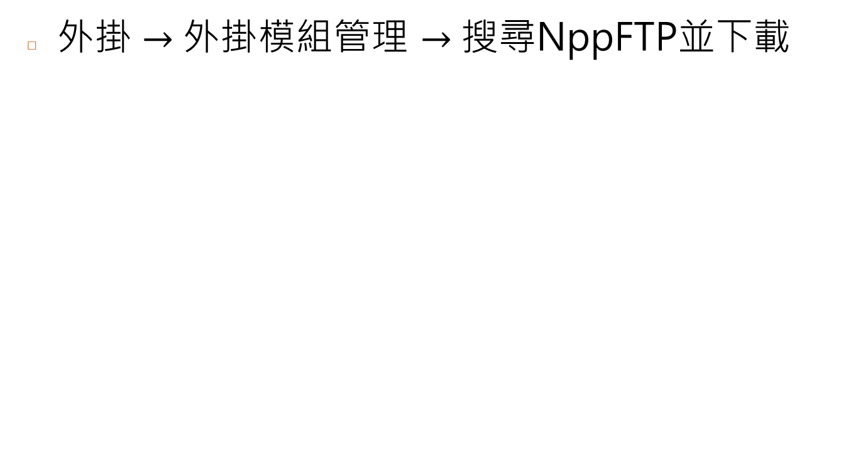
Notepad++ (Cont.)
外掛 $→$外掛模組管理 $→$搜尋NppFTP並下載

Slide 4
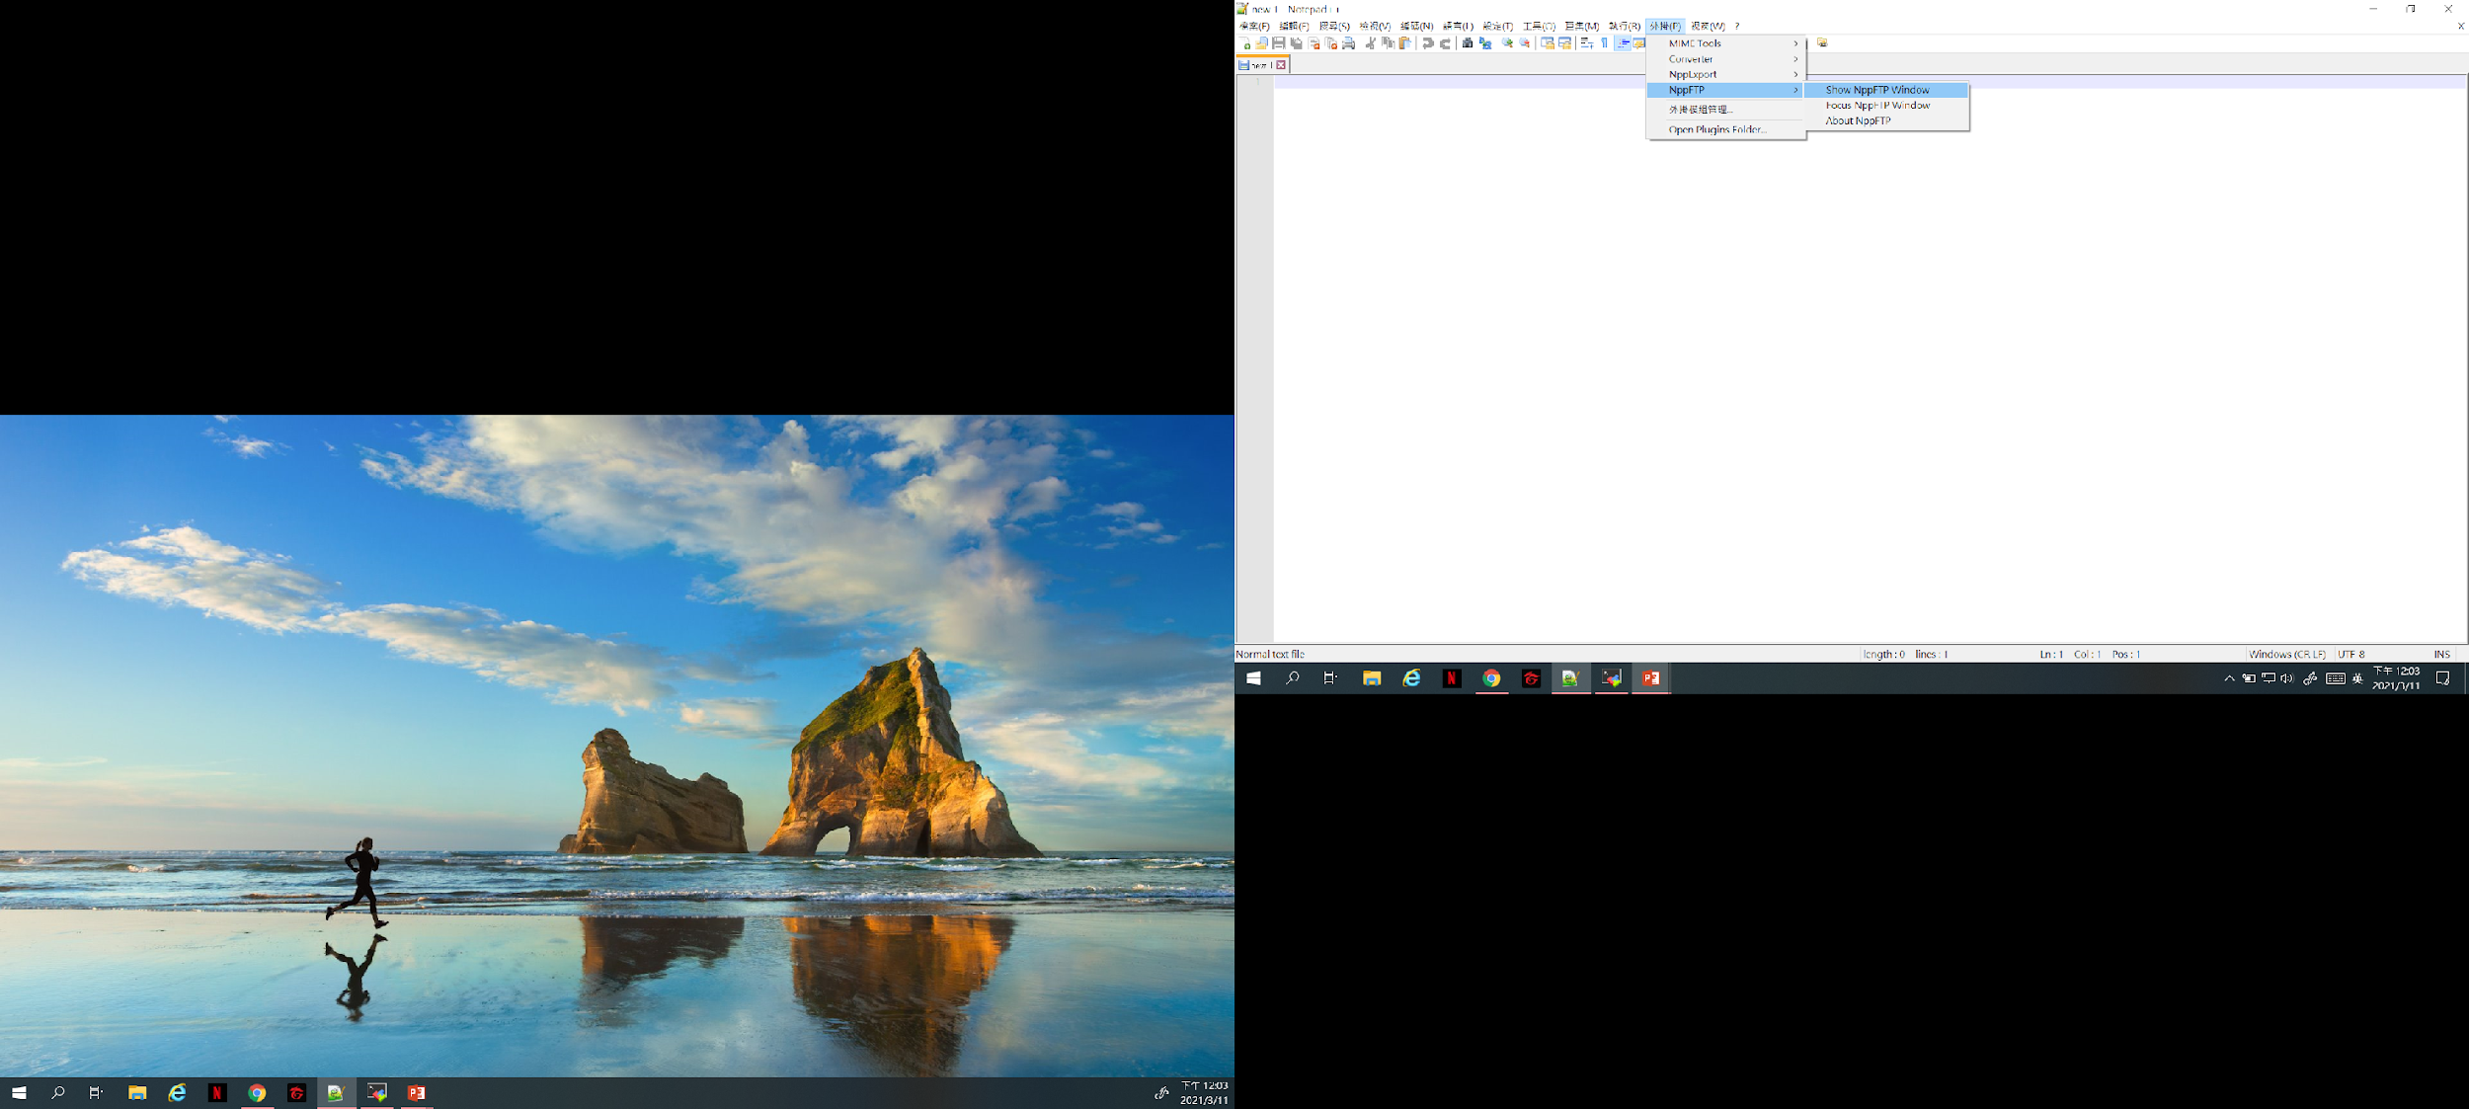
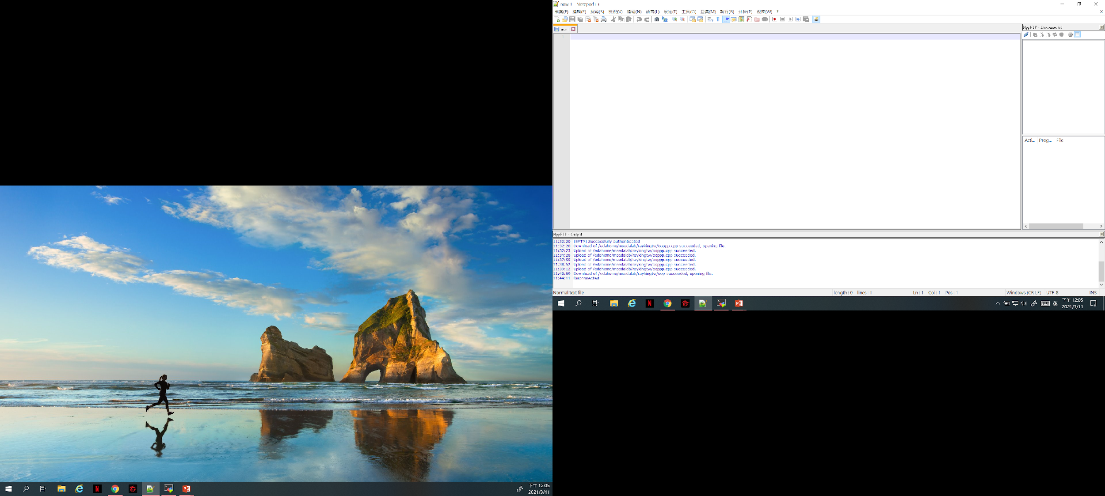

Notepad++ (Cont.)
外掛 $→$NppFTP $→$Show NppFTP Window

Slide 5
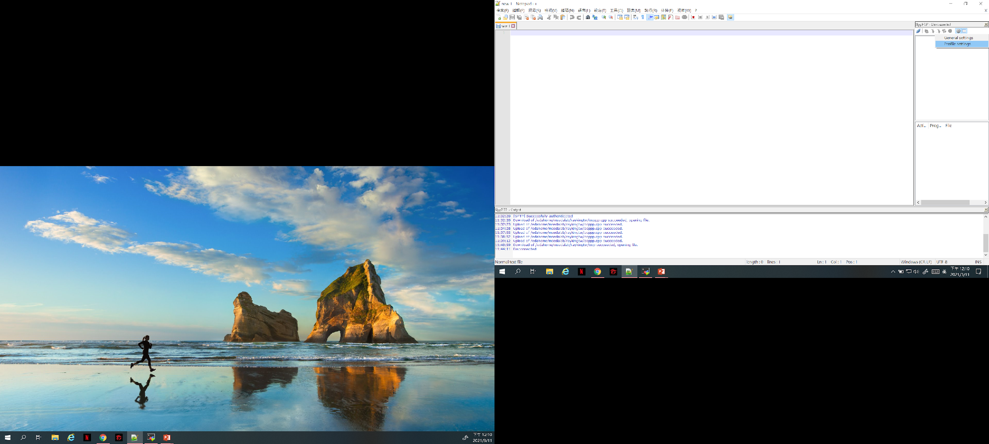
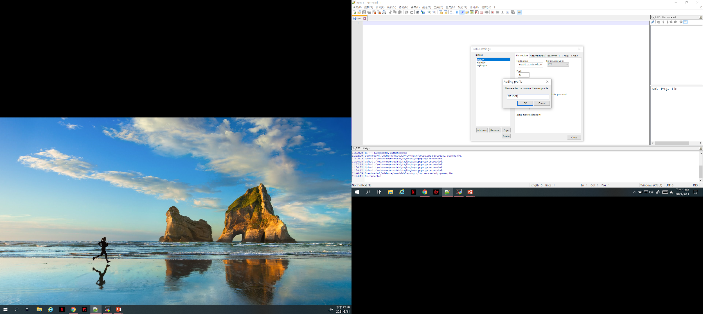

Notepad++ (Cont.)
Settings $→$Profile Settings

Slide 6
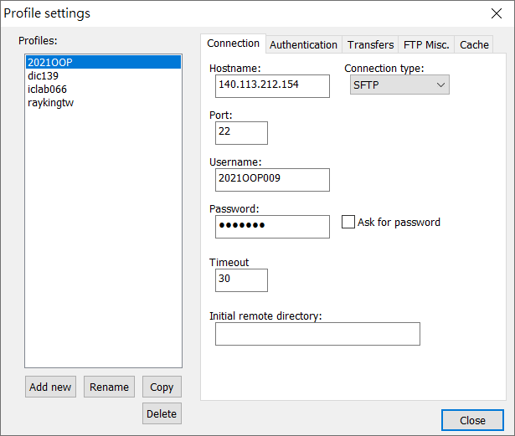
Notepad++ (Cont.)

Slide 7
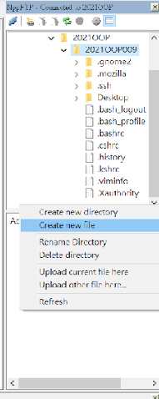
Notepad++ (Cont.)
在工作站上開啟cpp檔案，在右邊空白處點右鍵Creat new file

Slide 8
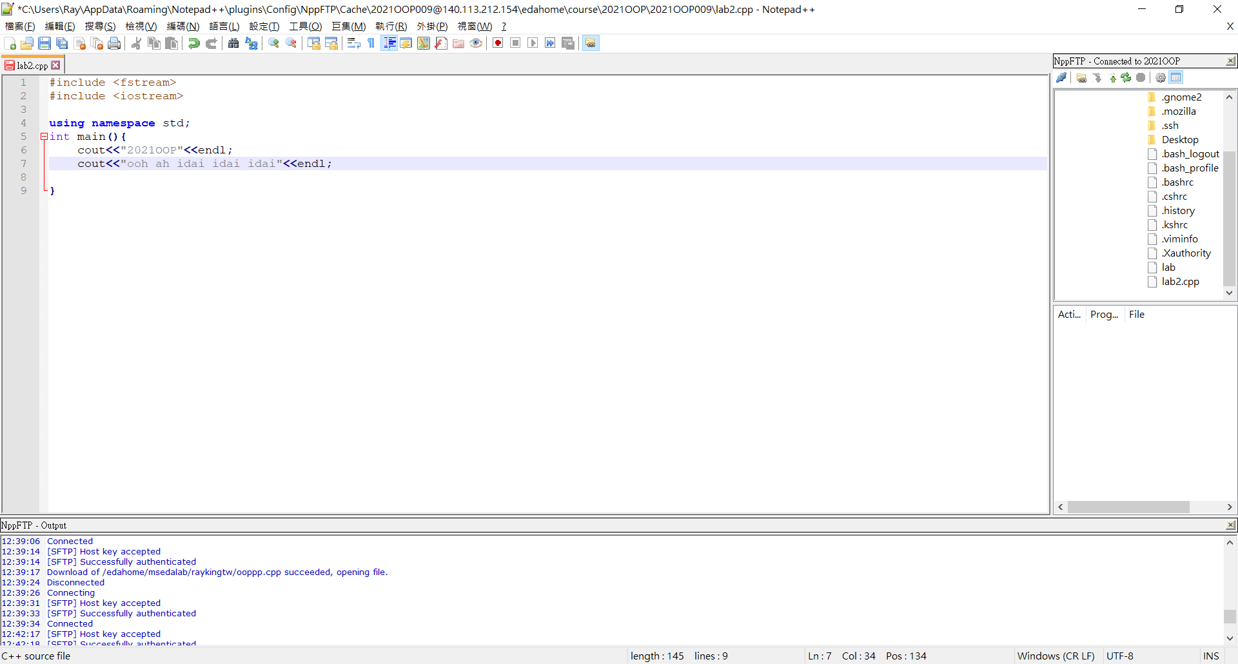

Coding
Coding $→$Ctrl+s存檔(or左上角存檔)

Slide 9
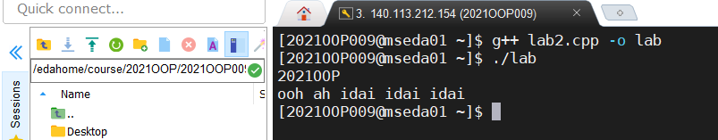
Compile & Run
Compile:
g++ <.cpp檔> -o <執行檔名>
EX: g++ lab2.cpp -o lab
Run:
./<執行檔名>
EX: ./lab

Slide 10
File I/O
Declare a file name variable
#include <fstream>
ifstream input_filename_var ; // input file
ofstream output_filename_var ; // output file
Open the file
input_filename_var.open( “.../file_path/filename” );
output_filename_var.open( “.../file_path/filename” );

Slide 11
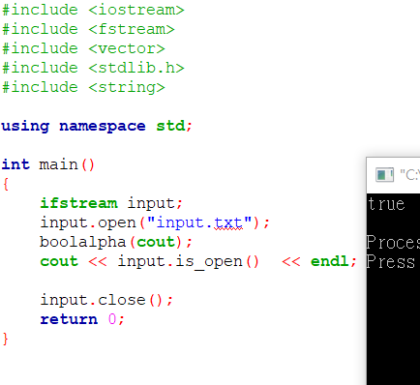
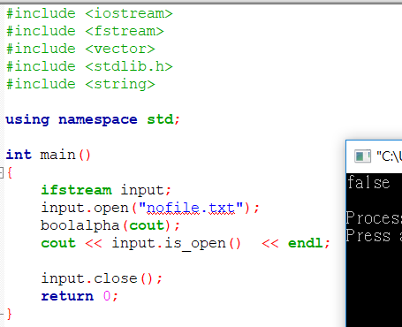
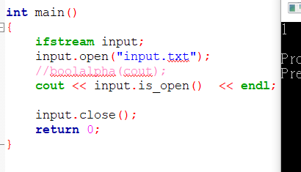
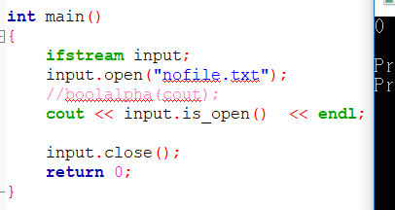
Check file opened successfully

Slide 12
Read file
Input file syntax just like input stream “cin”.
Example:
input_filename_var >> x >> y; // x and y are integers
input_filename_var >> ch; // ch is a char
ch = input_filename_var.get(); // ch is a char
input_filename_var.getline(ch, ch_num); //ch is char*, ch_num is streamsize
getline(input_filename_var, str_var); // str_var is string

Slide 13
Output file
Treat ofstream (output file stream) just as cout.
Example:
output_filename_var << x << y; // x and y are integers
output_filename_var << ch; // ch is a char
output_filename_var << “Hello World!” <<‘\n’; // literal string
output_filename_var << str; // str is a char* or string

Slide 14
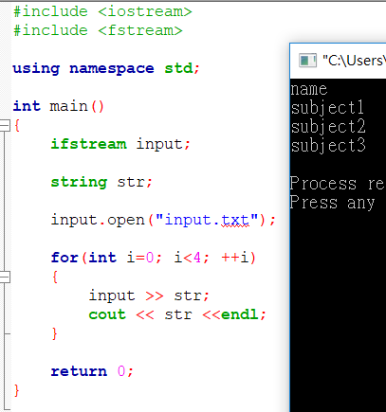
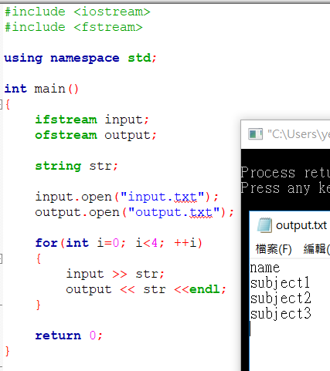
Output file (Cont.)
Using cout
Using ofstream

Slide 15
Close file
All opened files will be closed automatically after the execution of the program.
Always close the open files explicitly if they are no longer being used.
input_filename_var.close();
output_filename_var.close();

Slide 16
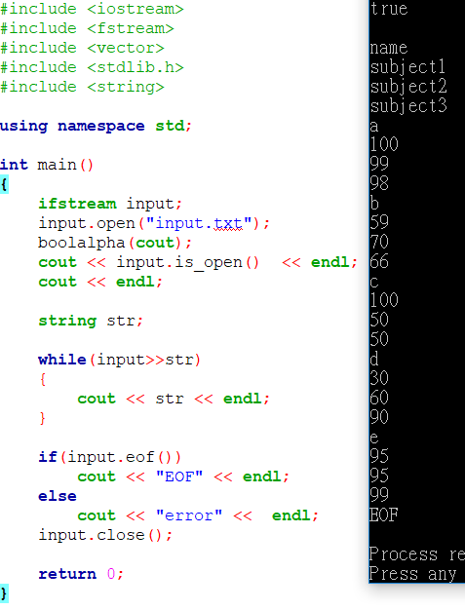
End of file (EOF)
string a;
while(input >> a){
…
}
while(!input.eof()){
input >> a;
…
}

Slide 17
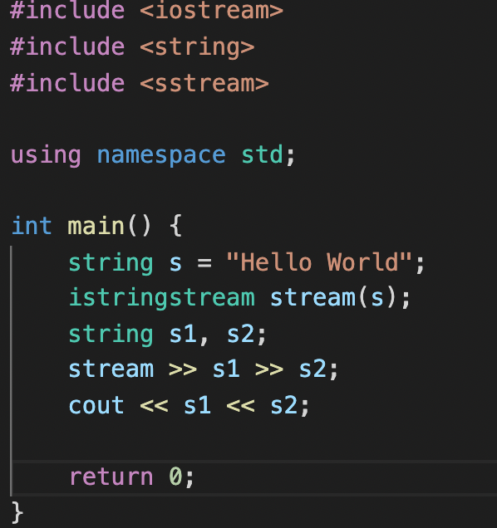
From string to stream
#include <sstream>
istringstream stream_name(string)

Slide 18

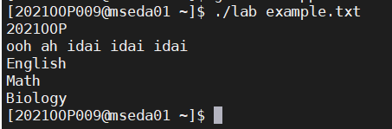
Information from terminal
int main(int argc, char **argv)
int main(int argc, char* argv[])
ifstream input
input.open(argv[1], ios::in)
Other arguments start from argv[1]
argv[0] is the name of your execution file

Slide 19
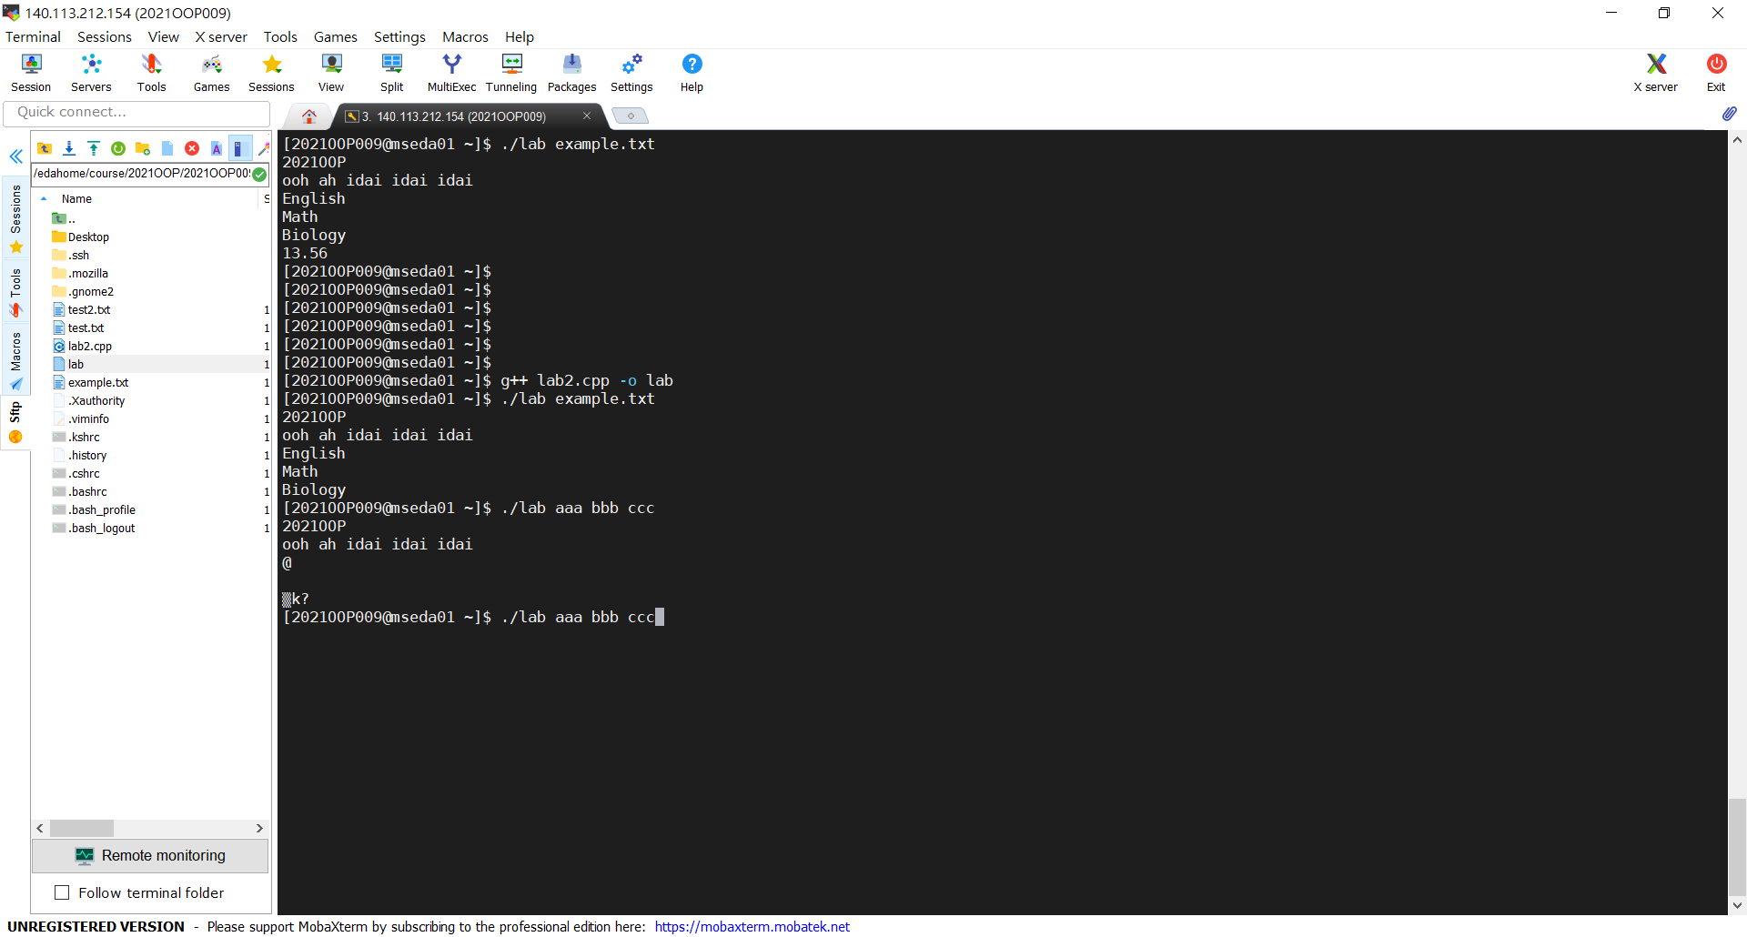

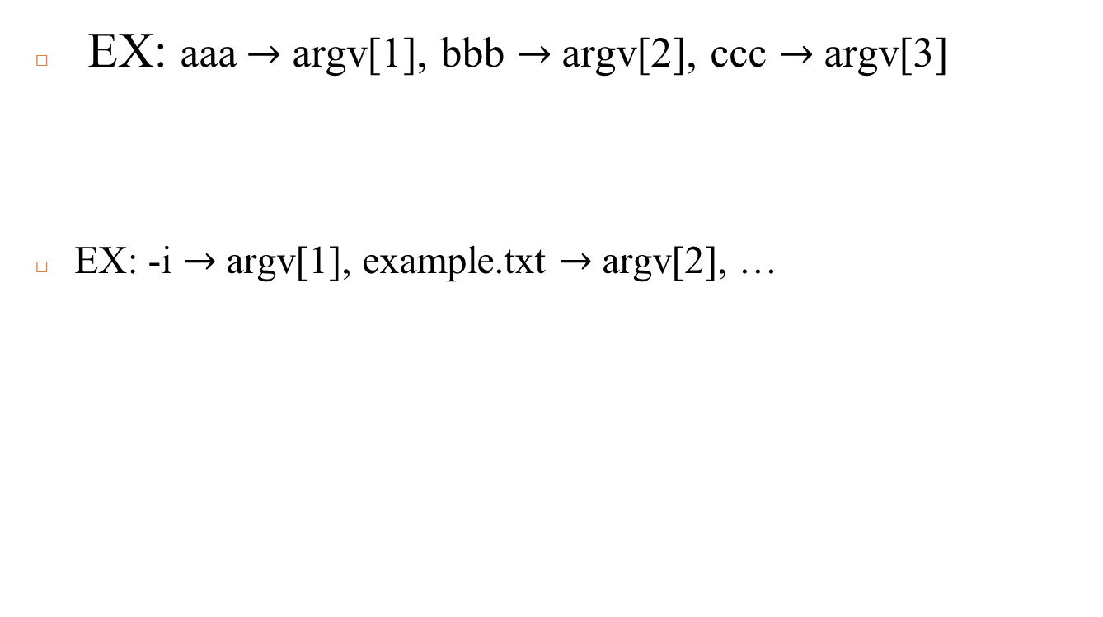
Information from terminal (Cont.)
EX: aaa$→$argv[1], bbb $→$argv[2], ccc $→$argv[3]
EX: -i $→$argv[1], example.txt $→$argv[2], …

Slide 20

Exercise – Interesting blocks
Download files “sample_input.txt” from newE3
Then you receive lots of special blocks, some of which can even be squeezed as you please…😲
Read input file by using argv[]

Slide 21
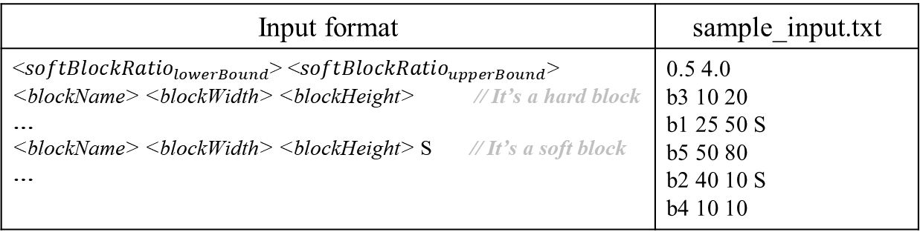
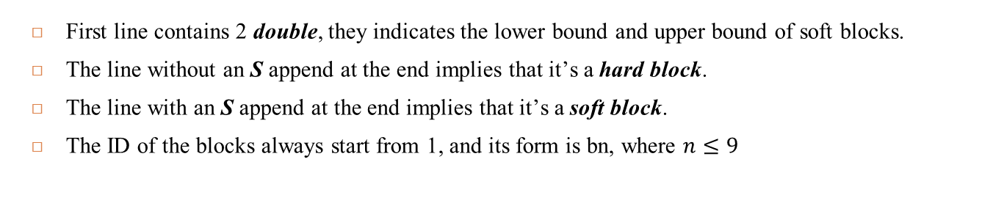
Exercise – Interesting blocks (Cont.)
Input explanation:
Input format | sample_input.txt
<${softBlockRatio}_{lowerBound}$> <${softBlockRatio}_{upperBound}$> <blockName> <blockWidth> <blockHeight> // It’s a hard block … <blockName> <blockWidth> <blockHeight> S // It’s a soft block … | 0.5 4.0 b3 10 20 b1 25 50 S b5 50 80 b2 40 10 S b4 10 10
First line contains 2 double, they indicates the lower bound and upper bound of soft blocks.
The line without an S append at the end implies that it’s a hard block.
The line with an S append at the end implies that it’s a soft block.
The ID of the blocks always start from 1, and its form is bn, where $n≤9$

Slide 22
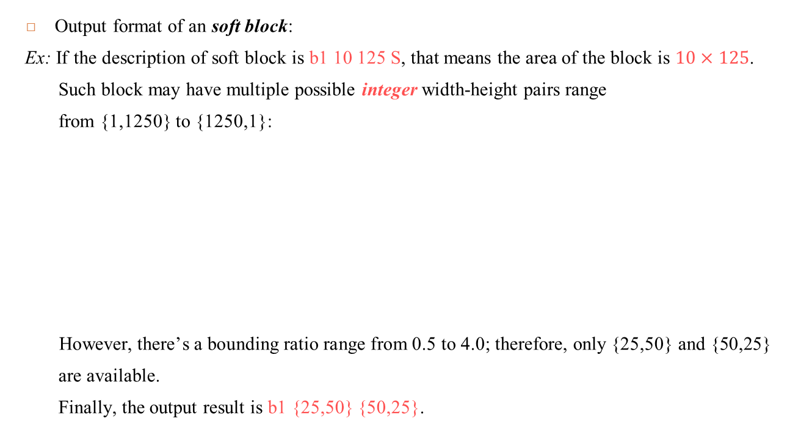
Exercise – Interesting blocks (Cont.)
Output explanation:
Output format of an soft block:
Ex: If the description of soft block is b1 10 125 S, that means the area of the block is $10×125$.
Such block may have multiple possible integer width-height pairs range
from {1,1250} to {1250,1}:
However, there’s a bounding ratio range from 0.5 to 4.0; therefore, only {25,50} and {50,25}
are available.
Finally, the output result is b1 {25,50} {50,25}.
25
b1
50
b1
…
50
125
25
10
b1
Some possible width-height pairs of soft block

Slide 23
Exercise – Interesting blocks (Cont.)
Output explanation:
Output format of an hard block:
Ex: If the line of the hard block is b3 10 20.
Directly output the only 2 width-height pairs: b1 {10,20} {20,10}.
10
b3
20
b3
20
10
All possible width-height pairs of hard block

Slide 24
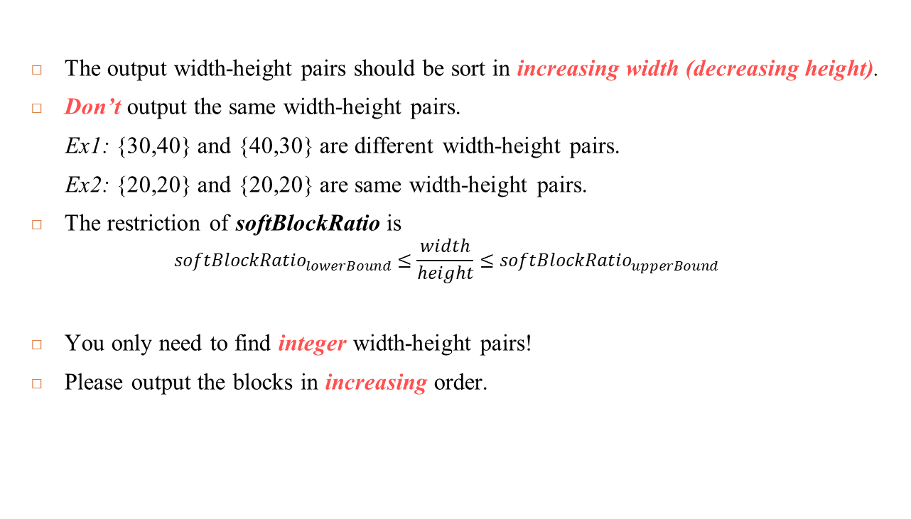
Exercise – Interesting blocks (Cont.)
Output explanation:
The output width-height pairs should be sort in increasing width (decreasing height).
Don’t output the same width-height pairs.
Ex1: {30,40} and {40,30} are different width-height pairs.
Ex2: {20,20} and {20,20} are same width-height pairs.
The restriction of softBlockRatio is
$${softBlockRatio}_{lowerBound}≤\frac{width}{height}≤{softBlockRatio}_{upperBound}$$
You only need to find integer width-height pairs!
Please output the blocks in increasing order.

Slide 25
Exercise – Interesting blocks (Cont.)
Sample output:
You can check sample_output.txt to confirm the output format.
b1 {25,50} {50,25}
b2 {16,25} {20,20} {25,16} {40,10}
b3 {10,20} {20,10}
b4 {10,10}
b5 {50,80} {80,50}

Slide 26
Exercise – Interesting blocks (Cont.)
Create a directory “OOP112” (mkdir OOP112)
Change your working directory to “OOP112” (cd OOP112)
Create a cpp file “Lab-02.cpp” (touch Lab-02.cpp)
Write your code in Lab-02.cpp
Use following command to demo:
/home/share/demo_OOP112 Lab 02

Slide 27
Submission
Ask TAs for demo
Try your best to debug your code by yourself
Upload all your cpp to new E3
Naming rule : studentID_lab2.cpp

